Slide 1
Shiksha Daan
(The Gift of Education)
An initiative of FICA – Federation of India Community Associations
8th Annual Volunteer Appreciation and Open House
Sept. 11, 2022
shikshadaan.fica@gmail.com
www.shikshadaan.org
Thanks to Neeti & Vijay Sharma and Lotus Banquet Hall
for Sponsoring this event

Slide 2
Shiksha Daan
The Gift of Education
Agenda
Shiksha Daan Presentation
Overview
Brief Discussion of Current Programs including perspectives from volunteers as well as students
Finances and Giving to Partner Organizations
Q&A
Lunch and open networking
Learn more details about specific programs and sign up as volunteer
shikshadaan.fica@gmail.com

Slide 3
Shiksha Daan
The Gift of Education
Shiksha Daan was established in July 2013 as an activity of FICA
Objective: Get the Indian community actively involved with the education and development of underprivileged youth and adults in Greater Cleveland
Our approach is to conduct our own tutoring program, as well as partner with other organizations which support youth education and development
We reach out to the Indian community to volunteer as tutors and mentors
Background & Status
Since our inception we:
Established a tutoring program in Cleveland Heights which operated for 8 years and established a tutoring program on the Cleveland Westside which operated for 4 years. In person tutoring was discontinued in March 2020 because of COVID
Established an online tutoring program in April 2020
Established robust partnerships with: College Now, Refugee Response and Seeds of Literacy

Slide 4
Shiksha Daan
The Gift of Education
Shiksha Daan Committee
Sanjay Garg, Chair
Gita Gidwani
Keyuri Harzarnis
Meera Kansal
Shivangi Mohta
Vinod Nagpal
Prashanth Subramanian
Pranay Verma
Past Members: Vijay Julka, Sahithya Wyntrich, Ramesh Shah, Hemant Kanodia, Swati Sathe, Akhilesh Chowksy, Sangita Bafna, Nivi Engineer, Gowri Mohandoss, Mala Garg
shikshadaan.fica@gmail.com

Slide 5
Shiksha Daan
The Gift of Education
Shiksha Daan by the Numbers
Sept. 2021 to May 2022
20 Refugee/Low Income students tutored online through our own programs
12 College Students mentored through College Now program
3 students mentored through the Refugee Response program
Multiple adults tutored through the Seeds of Literacy Program
Over 40 active volunteers giving their time for tutoring/mentoring
Over 1500 Volunteer Hours Contributed to help with under-privileged youth and adult education

Slide 6
Shiksha Daan
The Gift of Education
A Big Thank You To All The
Shiksha Daan Volunteers

Slide 7
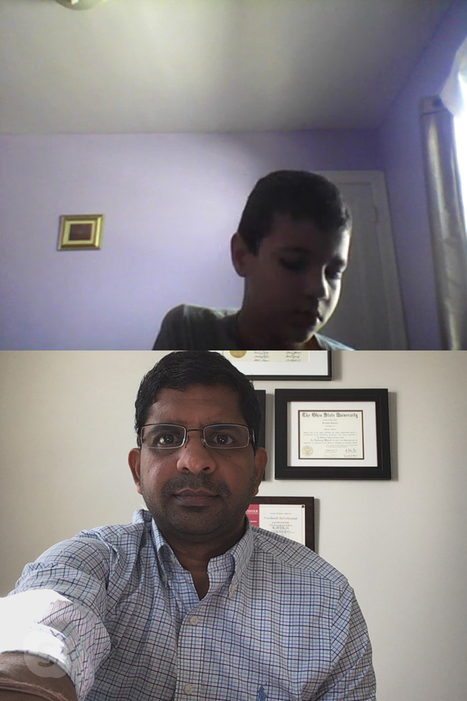
Shiksha Daan
The Gift of Education
Online Tutoring Program
We moved to online tutoring in April 2020 because of the COVID situation
We started with 7 students in April 2020 and had 21 students in our program by Jan. 2022.
Students are from Refugee families – Nepali, Middle Eastern, Afghani
Operation:
We match the student with a volunteer tutor based on mutual interests and capability
The tutor works with the parent to set up a day/time for tutoring and the web based media (Skype, Zoom etc.) to be used for tutoring
Tutoring is done during the academic year for 2 hours a week on weekday evenings
We follow up with the tutors and the parents to see how the tutoring is coming along.

Slide 8
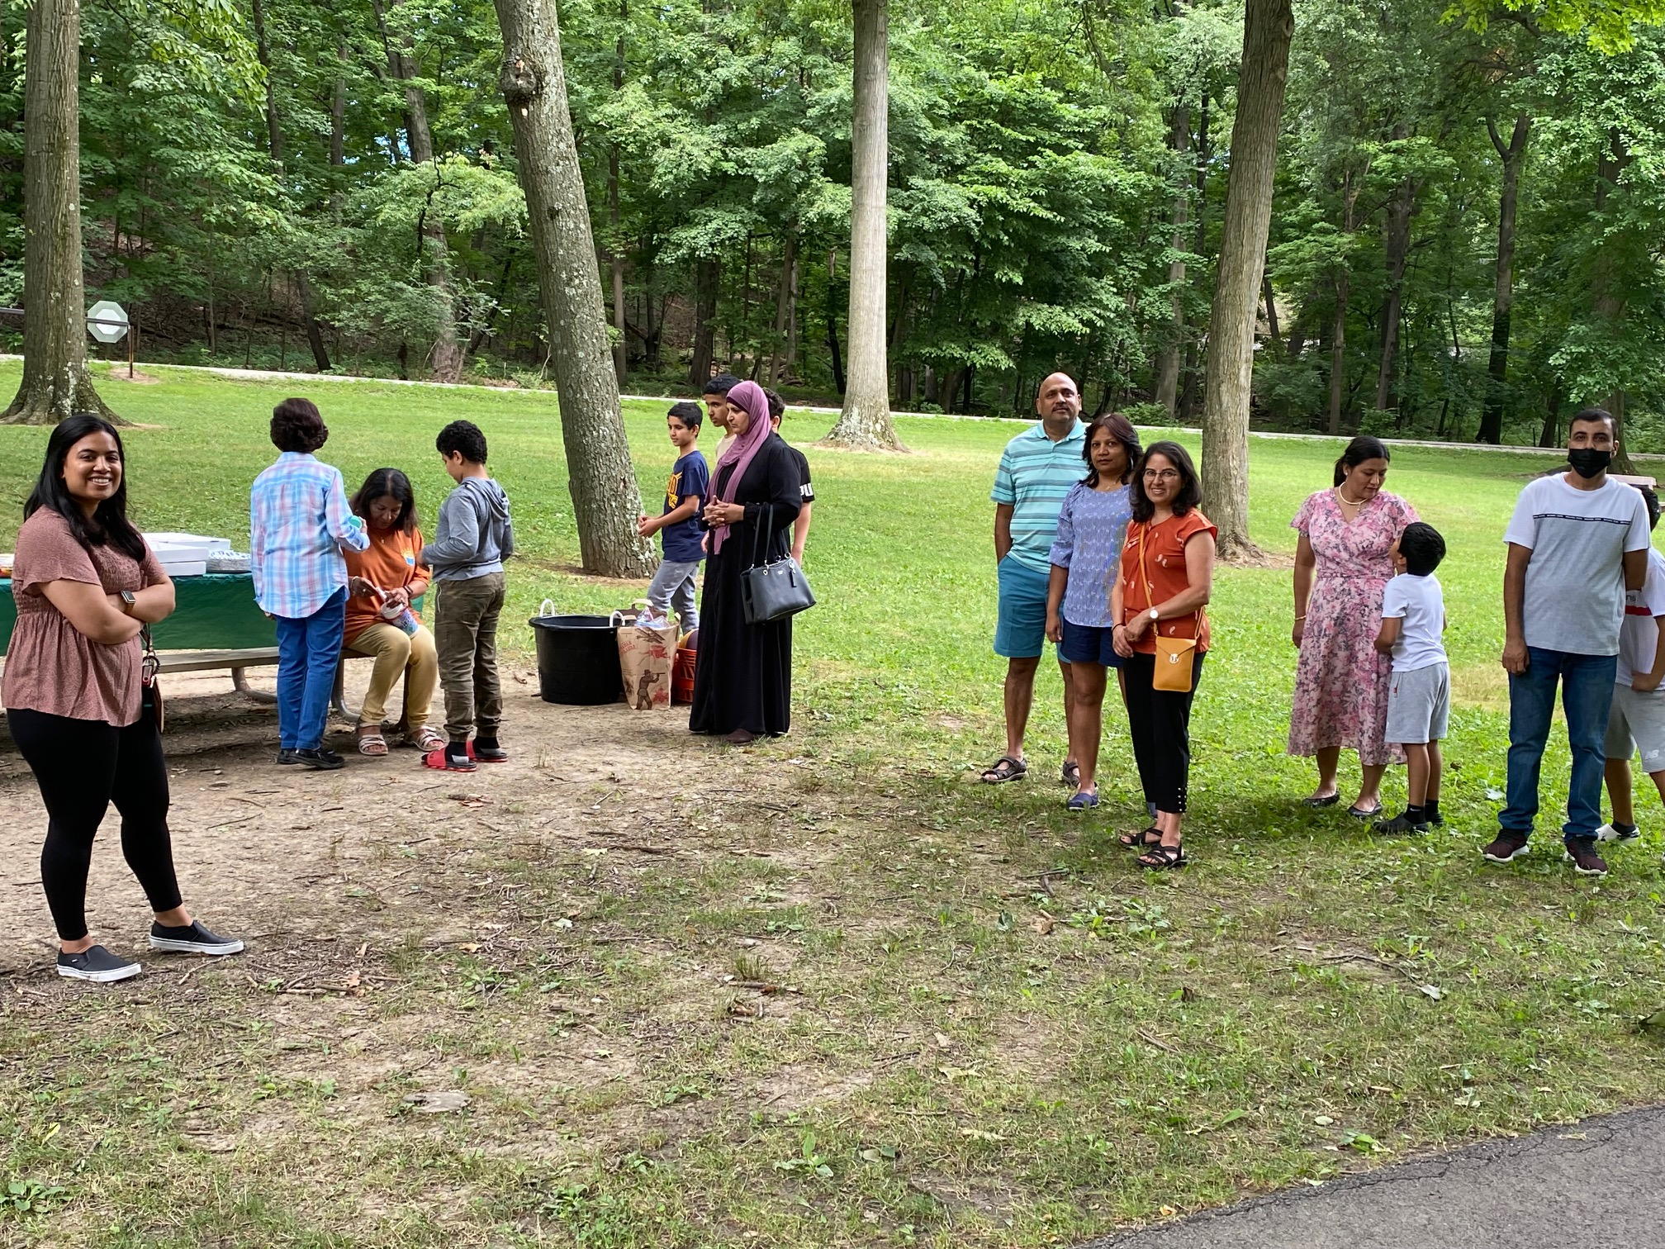
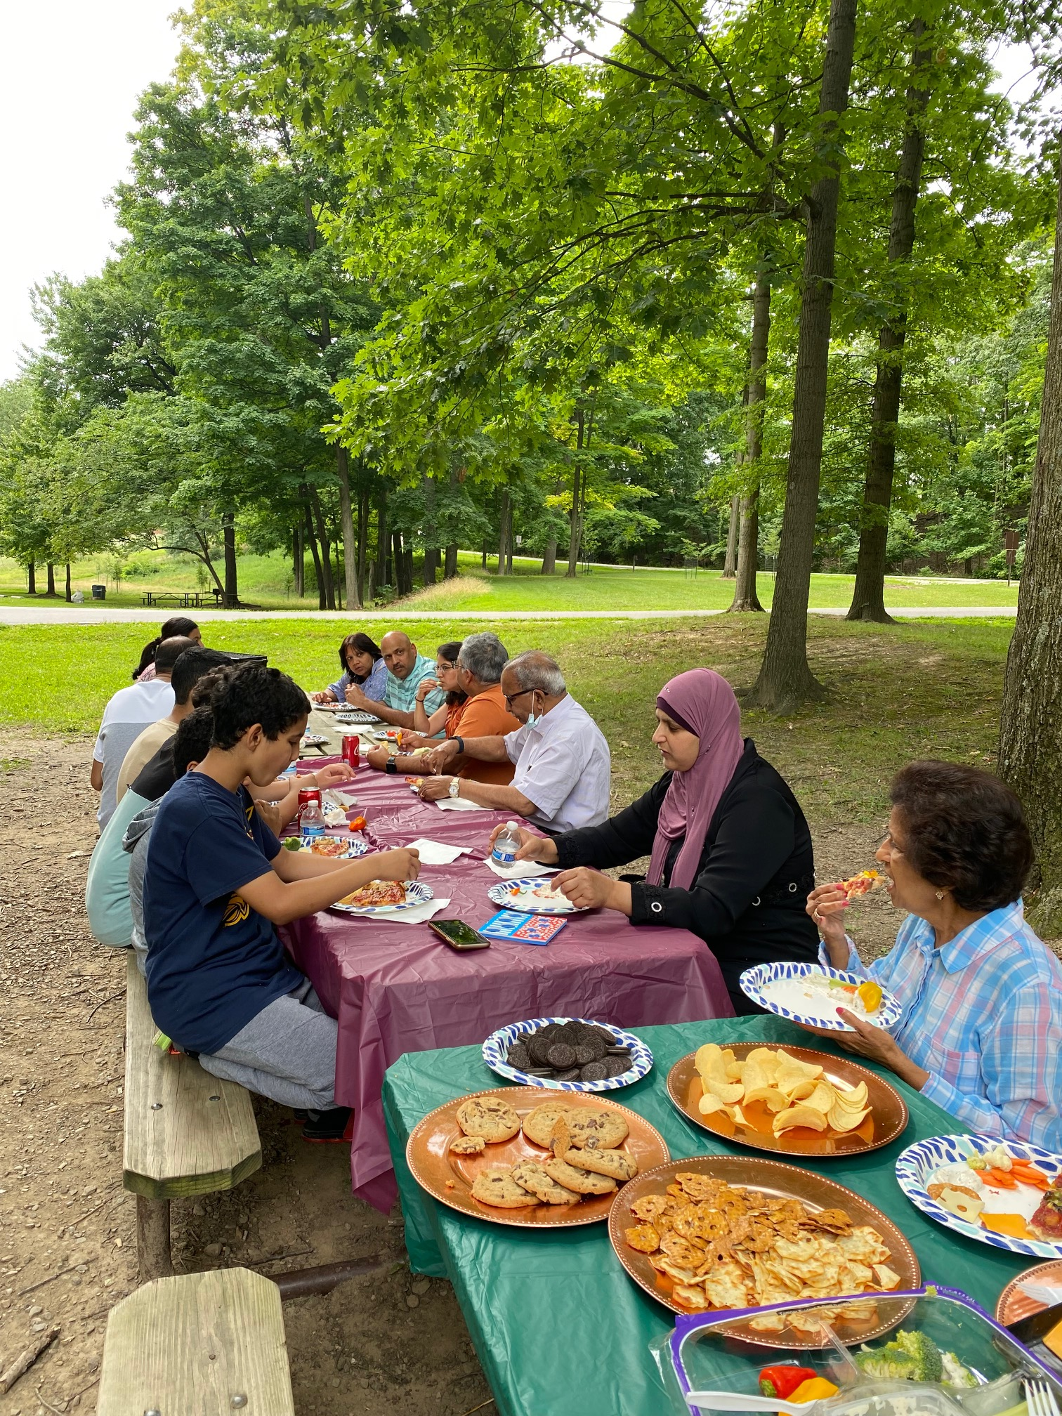
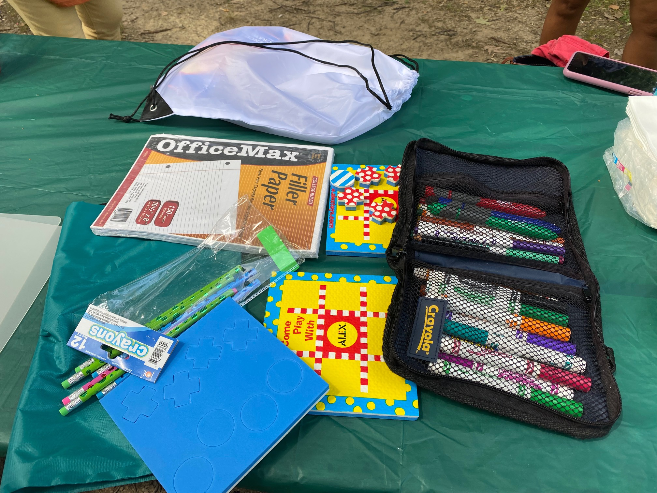
Shiksha Daan
The Gift of Education
Online Tutoring Program – contd.
All the students in our program have shown significant improvement in their grades.
Our student enrollment keeps on increasing through word of mouth from parents to their community members – we need more volunteer tutors to support the new students. Apply at www.shikshadaan.org
We held a tutor and student family picnic on July 31, 2022 at a picnic shelter in the Metro Parks

Slide 9
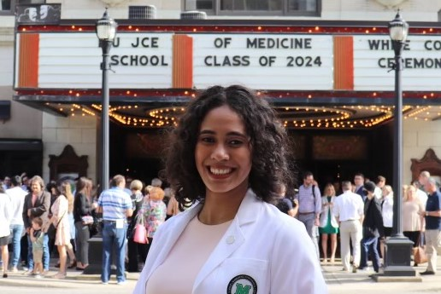
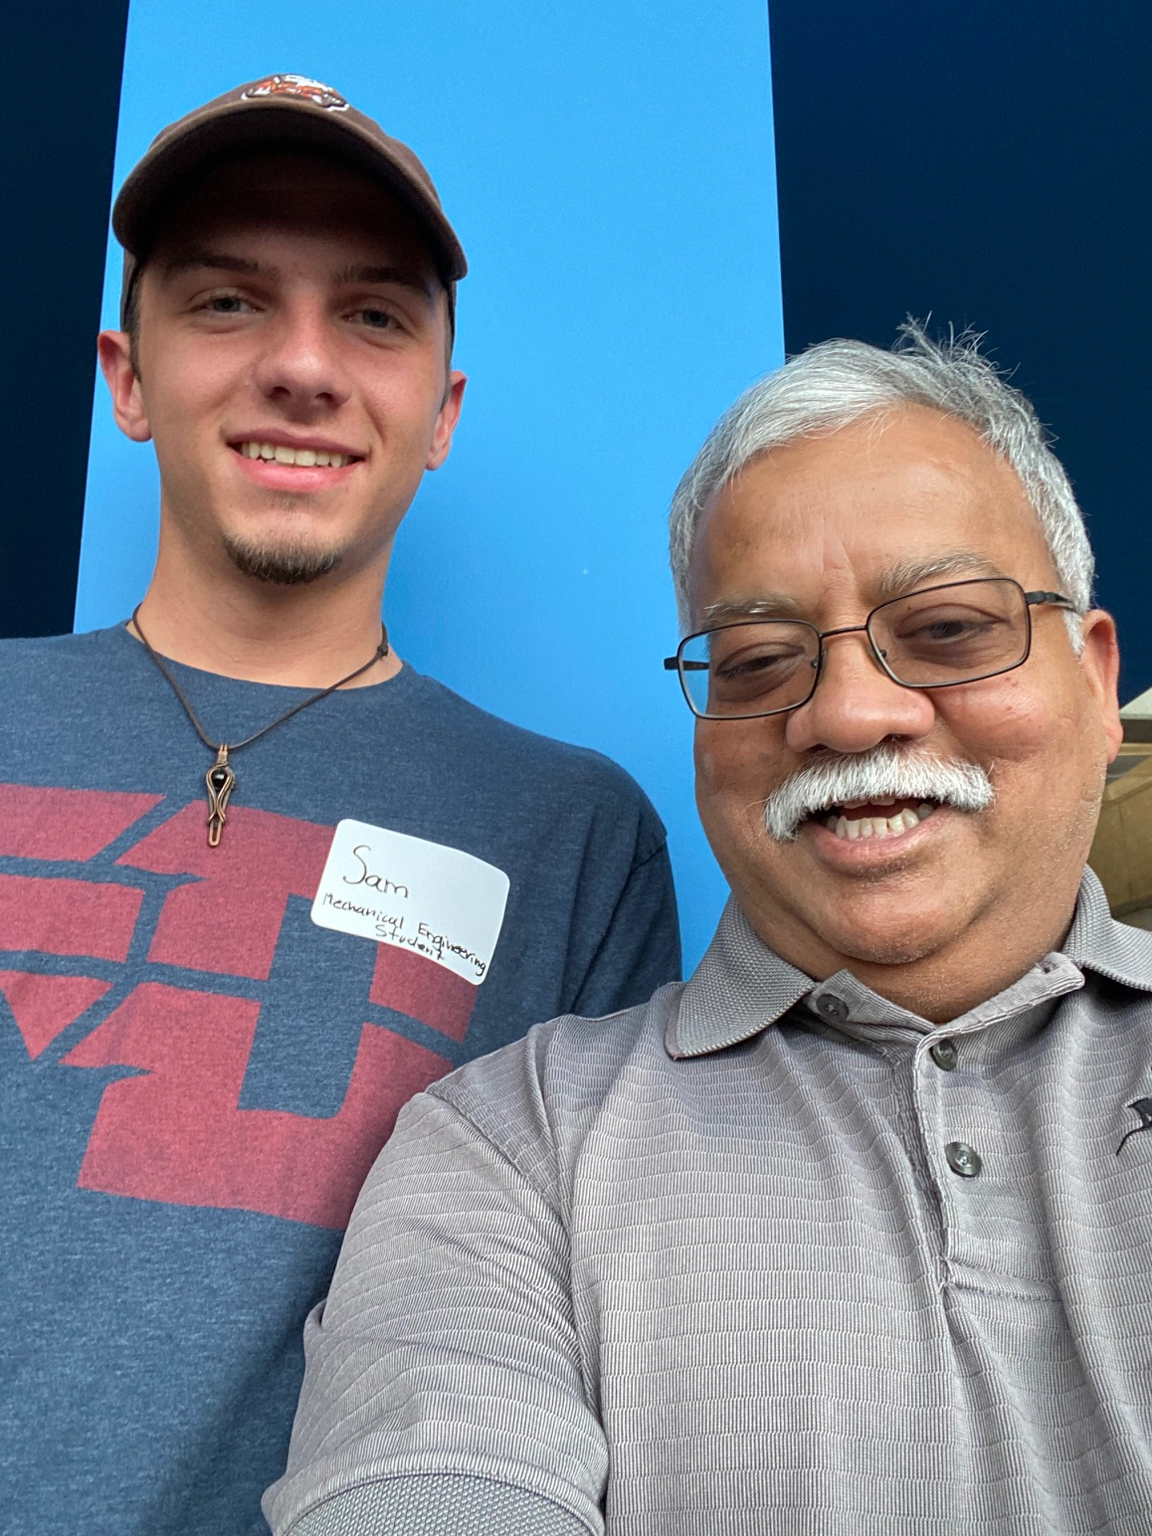
Shiksha Daan
The Gift of Education
College Now Mentoring
Partnership with College Now started in 2015
Mentor college students from low-income families. Mentoring is done mostly via phone/web with 3-4 in-person meetings expected during the academic year.
Need to apply through the College Now website
College Now provides training and the infrastructure for interaction with the student. Extensive support available to mentors
For 2021-22 school year, Shiksha Daan had 12 mentors paired with students. Many mentees completed their degree programs this summer.
We expect an additional 3 mentors to assigned mentees for 2022-23 Academic Year
Jessica Hall – Mentee of Gita Gidwani. Now in 3rd year of Medical School
Sanjay with mentee Sam
Mala Garg – 2021 Mentee of the Year Award Recipient

Slide 10
Shiksha Daan
The Gift of Education
The Refugee Response – Youth Mentoring Program
Partnership with Refugee Response started in 2015.
Provide one-on-one online tutoring/mentoring for two one-hour sessions per week during the school year.
Refugee Response does the screening of the family and student and provides training and support to mentors
Mentoring sessions are held on Tuesdays and Thursdays from 5-6 pm and 6-7 pm.
Prospective mentors required to complete an application, personal interview, and background check. One year commitment to mentor the student.
Shiksha Daan currently has 3 active mentors.
TRR also provides in person mentoring to students from refugee families at their office location. See Kate Nickley, TRR Youth Mentoring Program Manager for more information

Slide 11
Shiksha Daan
The Gift of Education
Seeds of Literacy – Adult Tutoring Program
Partnership with Seeds of Literacy started in 2020.
Seeds of Literacy provides tutoring to adults to help them complete their high school equivalent diploma.
Provide one-on-one online tutoring to adults for at least one two-hour session per week throughout the year.
Seeds of Literacy does the screening of the student and provides training and support to mentors
Tutoring sessions are held on Mon. to Thursdays, 9-11 am, 1-3 pm and 6-8 pm
Prospective mentors required to complete an application, personal interview, and background check.
From July 2021 to June 2022 4 Shiksha Daan volunteers did a total of 120 hours of tutoring for the program.
Seeds also offers in person tutoring to adults at their two office locations. See Kim Taylor from Seeds of Literacy for more information.

Slide 12
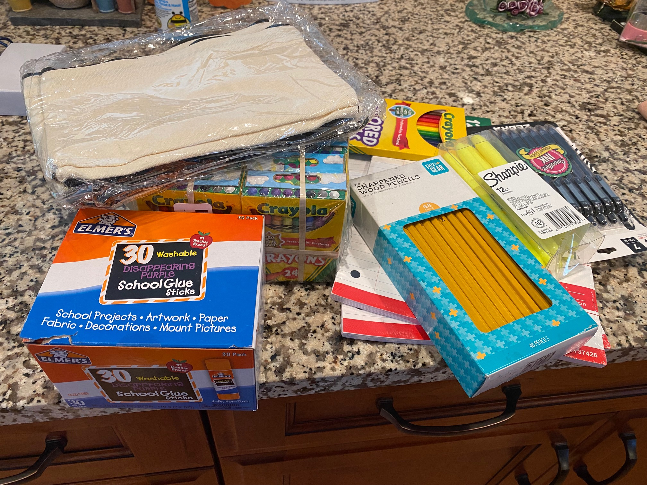
Shiksha Daan
The Gift of Education
Shiksha Daan – Additional Accomplishments
Developed a new website in 2021 – www.shikshadaan.org – Thanks to Manav Malik, Saija Shah and Prashant Subramanian. Shivangi Mohta has now taken over maintaining and updating the website
Made donations to our partners to help them with their programs:
Refugee Response – Donated $2000 to help them get licenses for educational software to use in their Youth Mentoring Program
Seeds of Literacy – Donated $1500 to pay for the Zoom license for the virtual tutoring program for the whole year, and also to support Testing for Adult Basic Education Assessment
Salvation Army Family Homeless Shelter – Donated $1500 worth of school supplies for students living in the shelter

Slide 13
Shiksha Daan
The Gift of Education
Thank you card from TRR Staff

Slide 14
Shiksha Daan
The Gift of Education
Financial Summary (3/1/2021 – 2/28/2022)
Beginning Balance: $12,189
Donations Received: $14,960
Expenses: $7088
Donation to Seeds of Literacy - $1000
Donation to Youth Opportunities Unlimited - $1000
Donation to Refugee Response - $1000
Shiksha Daan Website Licensing - $492
Gift Cards to Volunteers - $1350
School Supplies for Salvation Army Homeless Shelter - $2284 ($1181 is carryover from previous fiscal year
Ending Balance: $20,061

Slide 15
Shiksha Daan
The Gift of Education
Donating to Shiksha Daan
Thanks to our Donors – your support is very much appreciated
Since we have moved to online tutoring, we provide support to the families to ensure that they have the means for their children to participate
We also serve as a conduit for combining contributions from the community members and making meaningful contributions to organizations serving the education/development needs of students from low income families
How to Donate:
Go to www.shikshadaan.org and click on Donate button
Go to www.ficacleveland.org and click on Donate button. In the notes state that the contribution is for Shiksha Daan
Send a check made out to “FICA – Shiksha Daan” to Shiksha Daan, C/O Sanjay Garg, 28853 Woodmill Drive, Westlake OH 44145
Shiksha Daan is a project of FICA which is a 501(c)(3) registered organization. So contributions to Shiksha Daan are tax deductible.

Slide 16
Shiksha Daan
The Gift of Education
Thanks to the community for your Enthusiastic Support
Please consider signing up for one or more of our programs
Contact us at shikshadaan.fica@gmail.com if you are interested in volunteering with Shiksha Daan – as a tutor for our online tutoring program, or as a tutor/mentor with one of our partner programs
Help us spread the word about Shiksha Daan and get greater involvement from the Community
Questions? Suggestions?

